Slide 1
FinanceApp

Slide 2
App

Slide 3
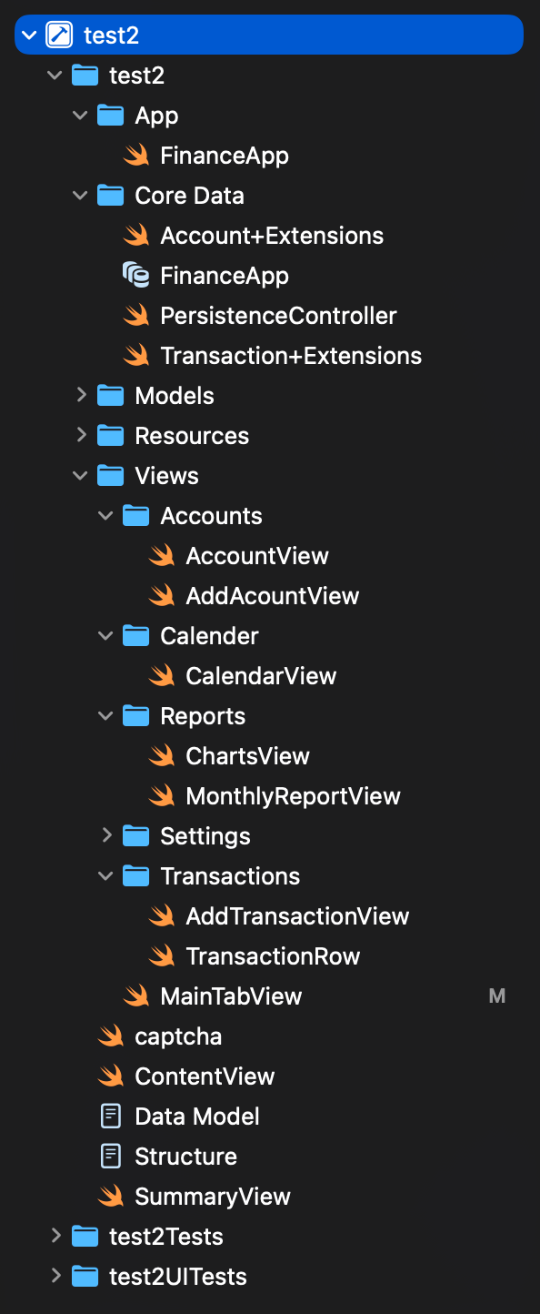
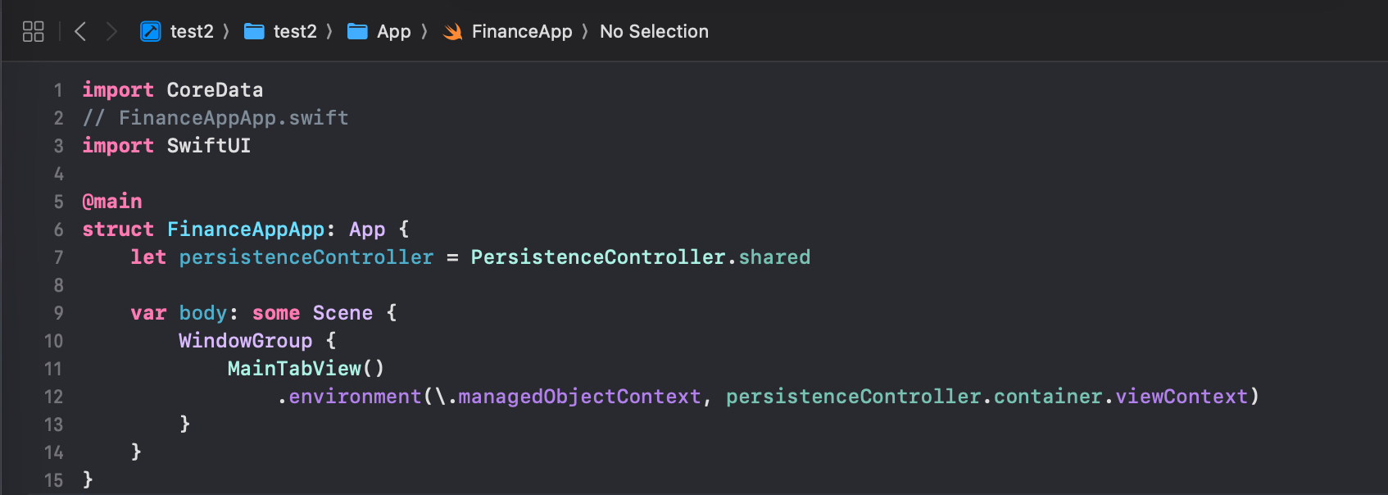
App->FinanceApp
開啟App的main函數，連接PersistenceController & MainTabView

Slide 4
Core Data

Slide 5
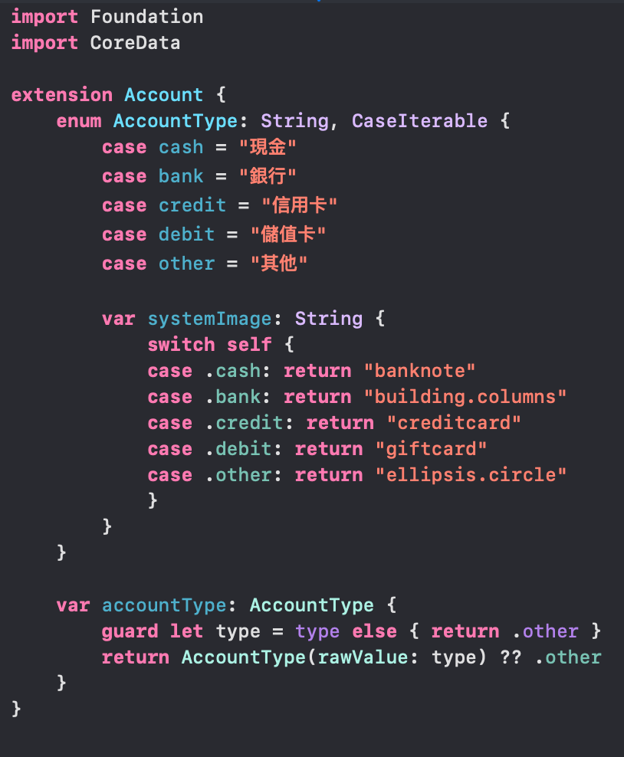
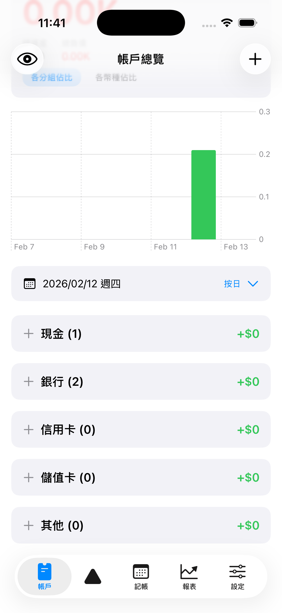
Core Data->Account+Extensions

Slide 6
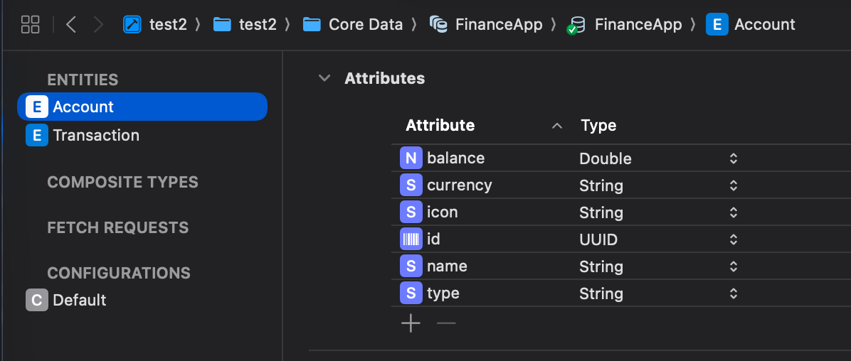
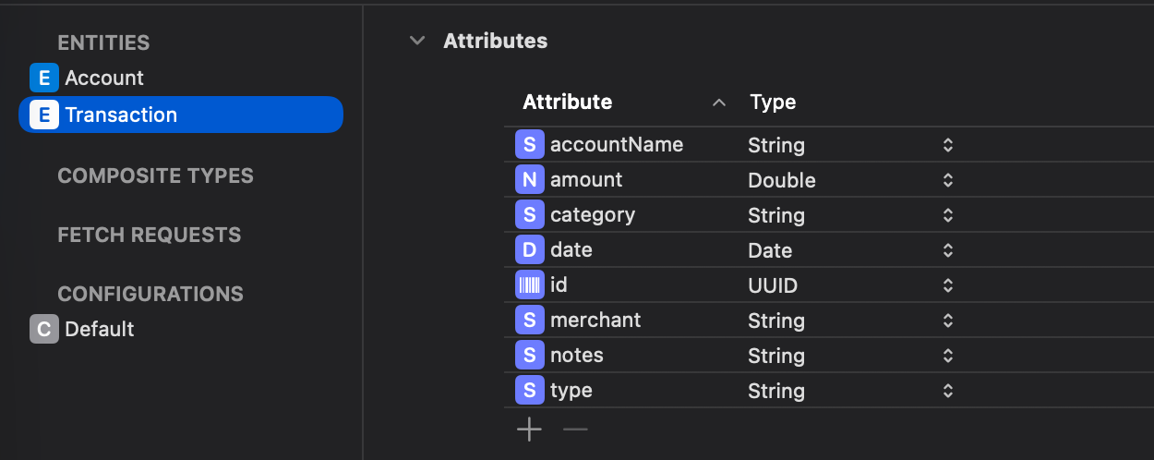
Core Data->FinanceApp.xcdatamodeld
Entity: 定義class用？
Account:
balance: 餘額(初始餘額)
currency: (TWD)
icon: // Not Used
name: 帳戶名稱(國泰)
type: (現金)
Transaction: 單筆交易細節
accountName: (台新)
Id: UUID
merchant: 商家
type: 收入/支出

Slide 7
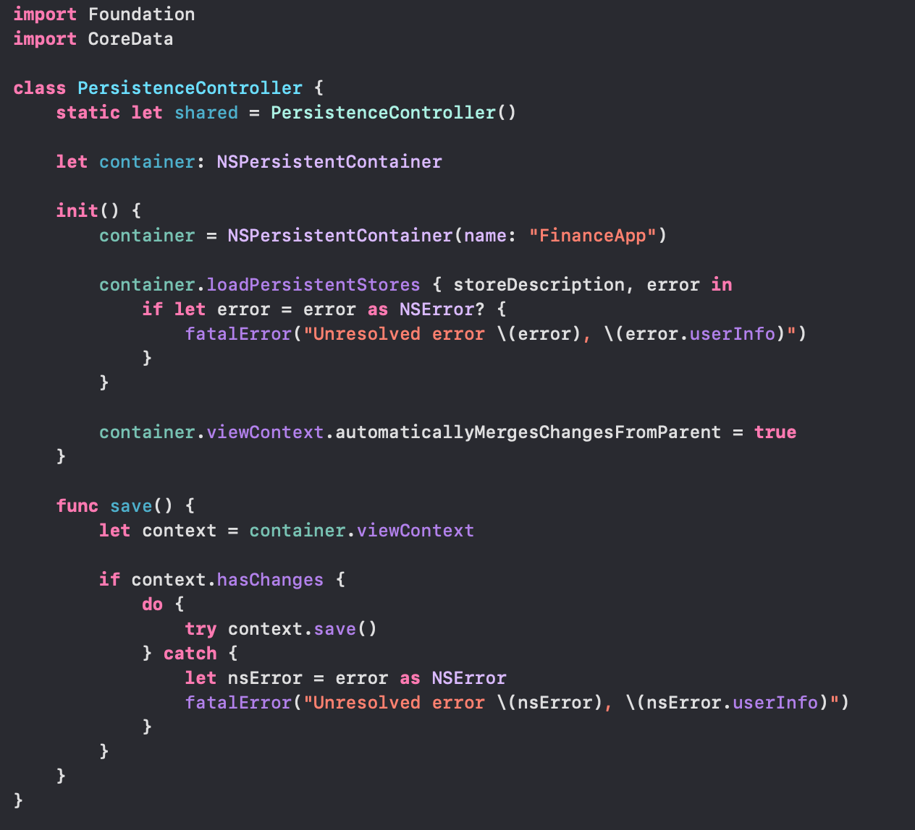
Core Data->PersistenceController
可操控CloudKit Sync, 目前只有本地端適用
若hasChanges, 則save to Parents

Slide 8
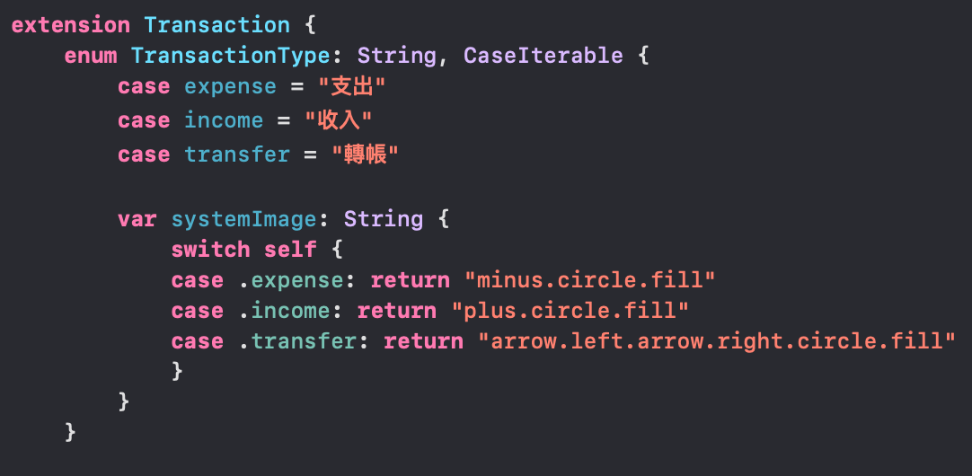
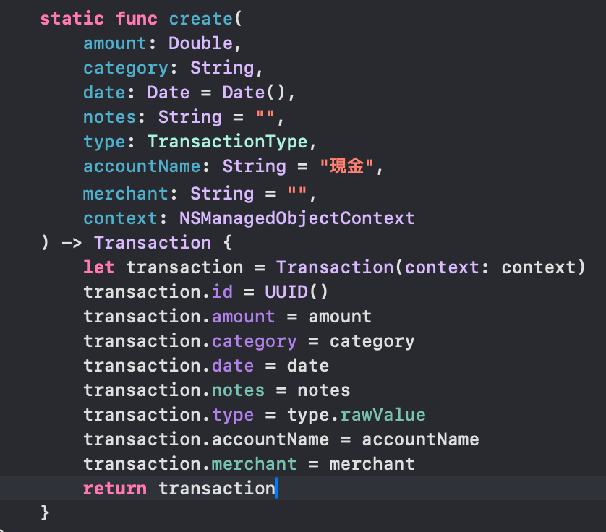
Core Data->Transaction+Extensions
Transaction create

Slide 9
Models

Slide 10
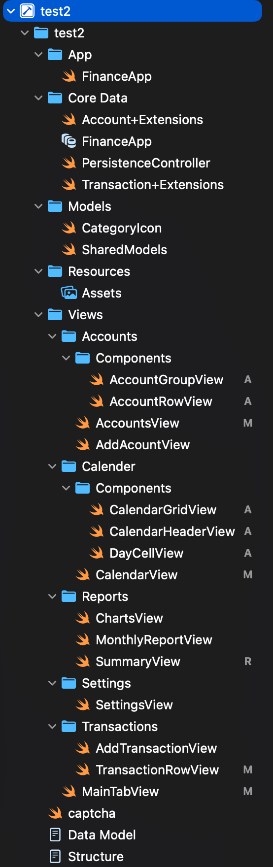

Models->CategoryIcon
Icon設定： 圓圈大小，圖片，顏色
Data List of Icons
尚未建立消費分組
顏色
Icon
新增自訂義

Slide 11
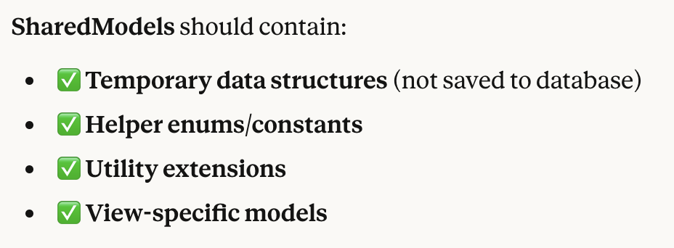
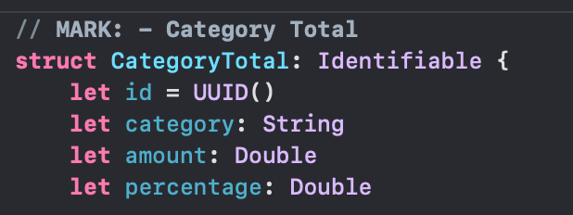
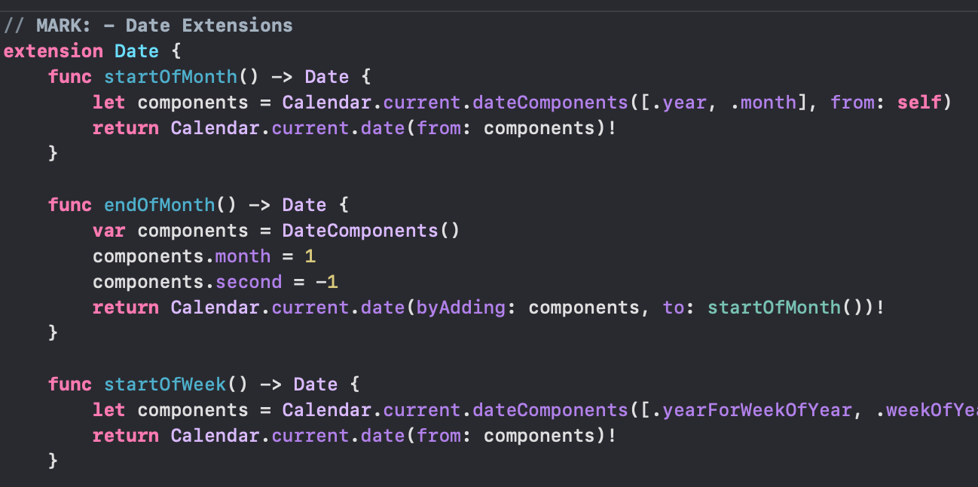
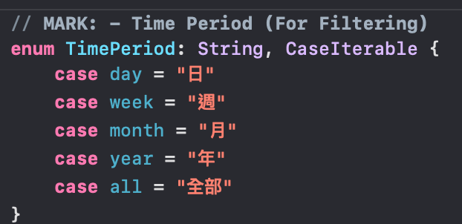
Models->SharedModels
每月報表
目前只用前兩個函數
(還沒用)

Slide 12
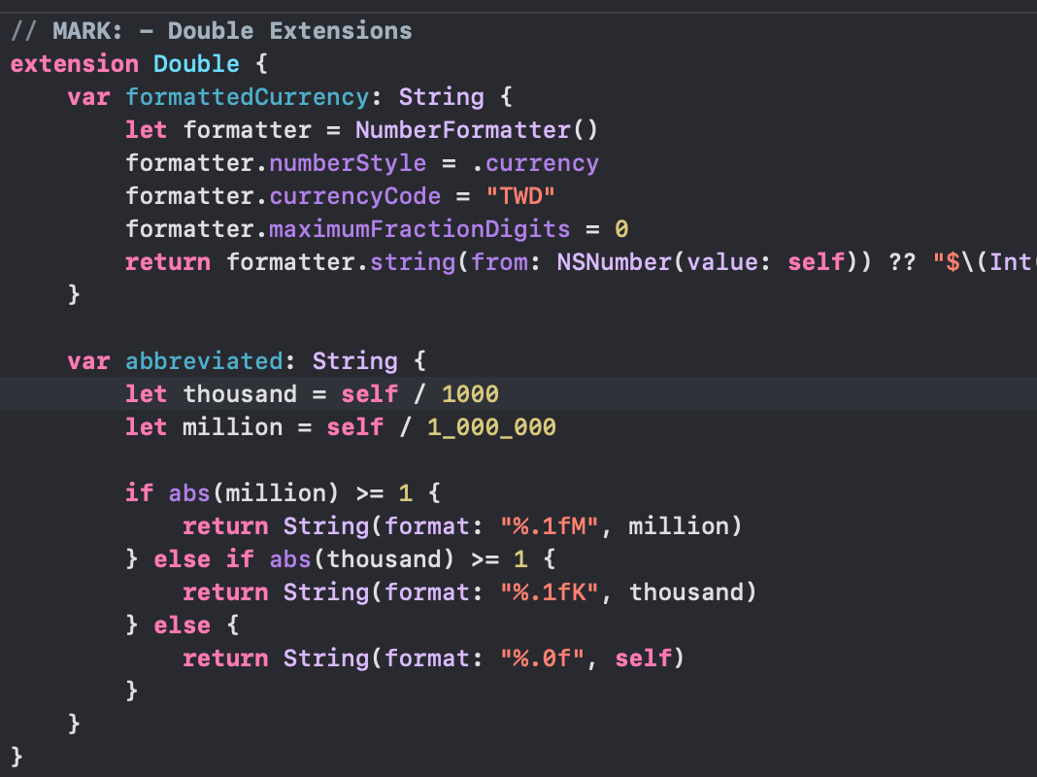
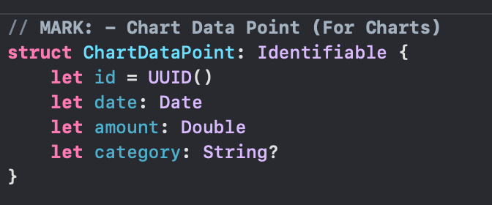
Models->SharedModels
(還沒用)

Slide 13
Resources

Slide 14
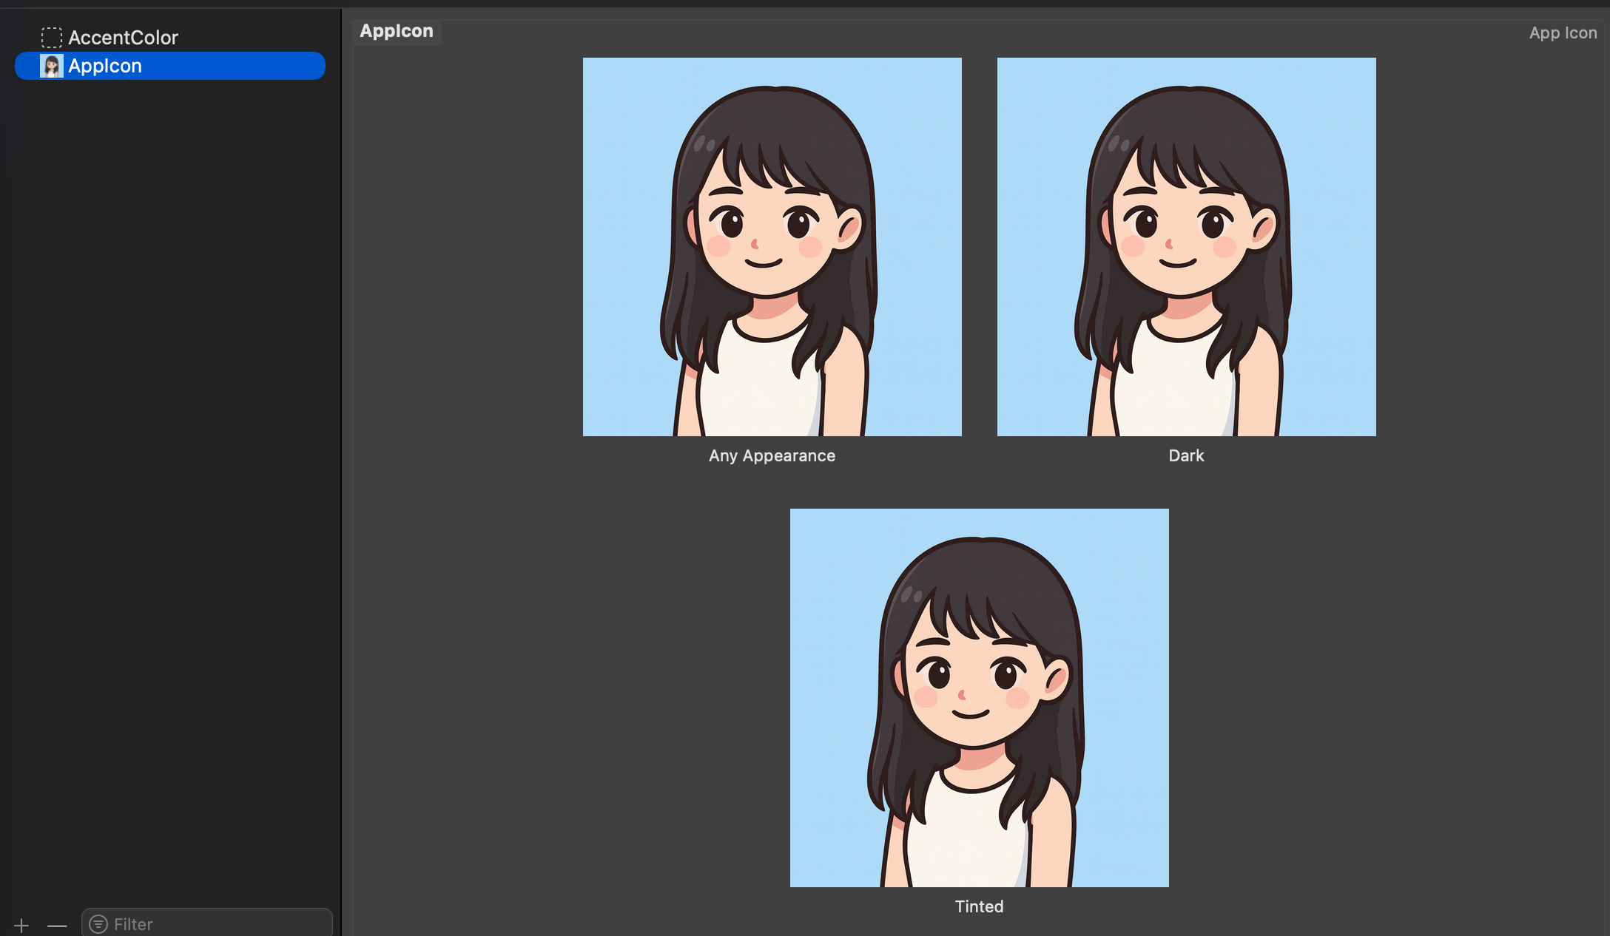
Resources->Assets

Slide 15
Views

Slide 16
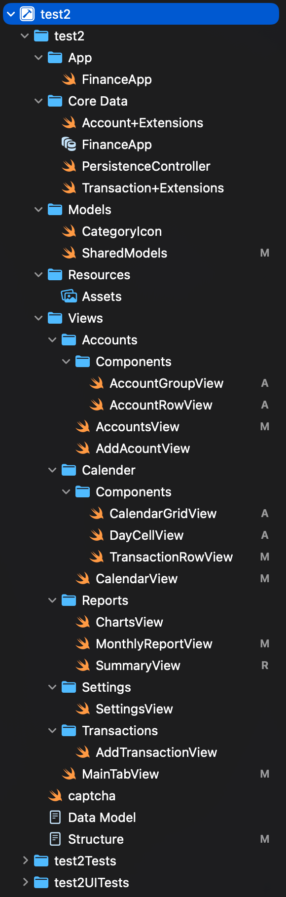
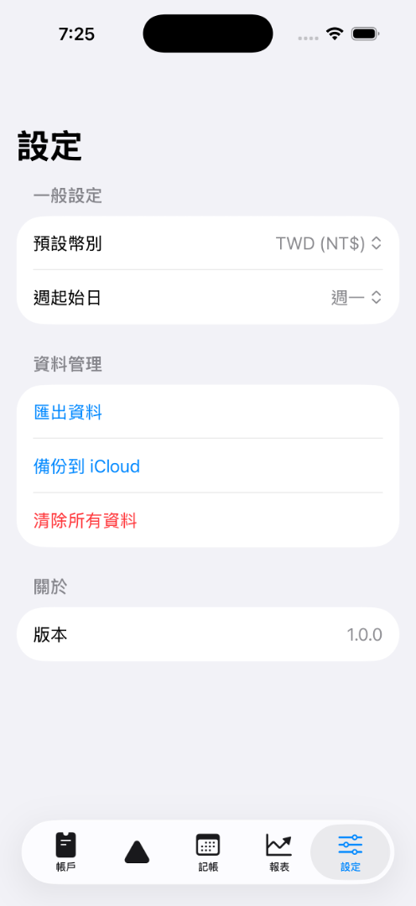
Views->MainTabView
再多想一個功能取代現有第二個空的

Slide 17
Views->Accounts

Slide 18
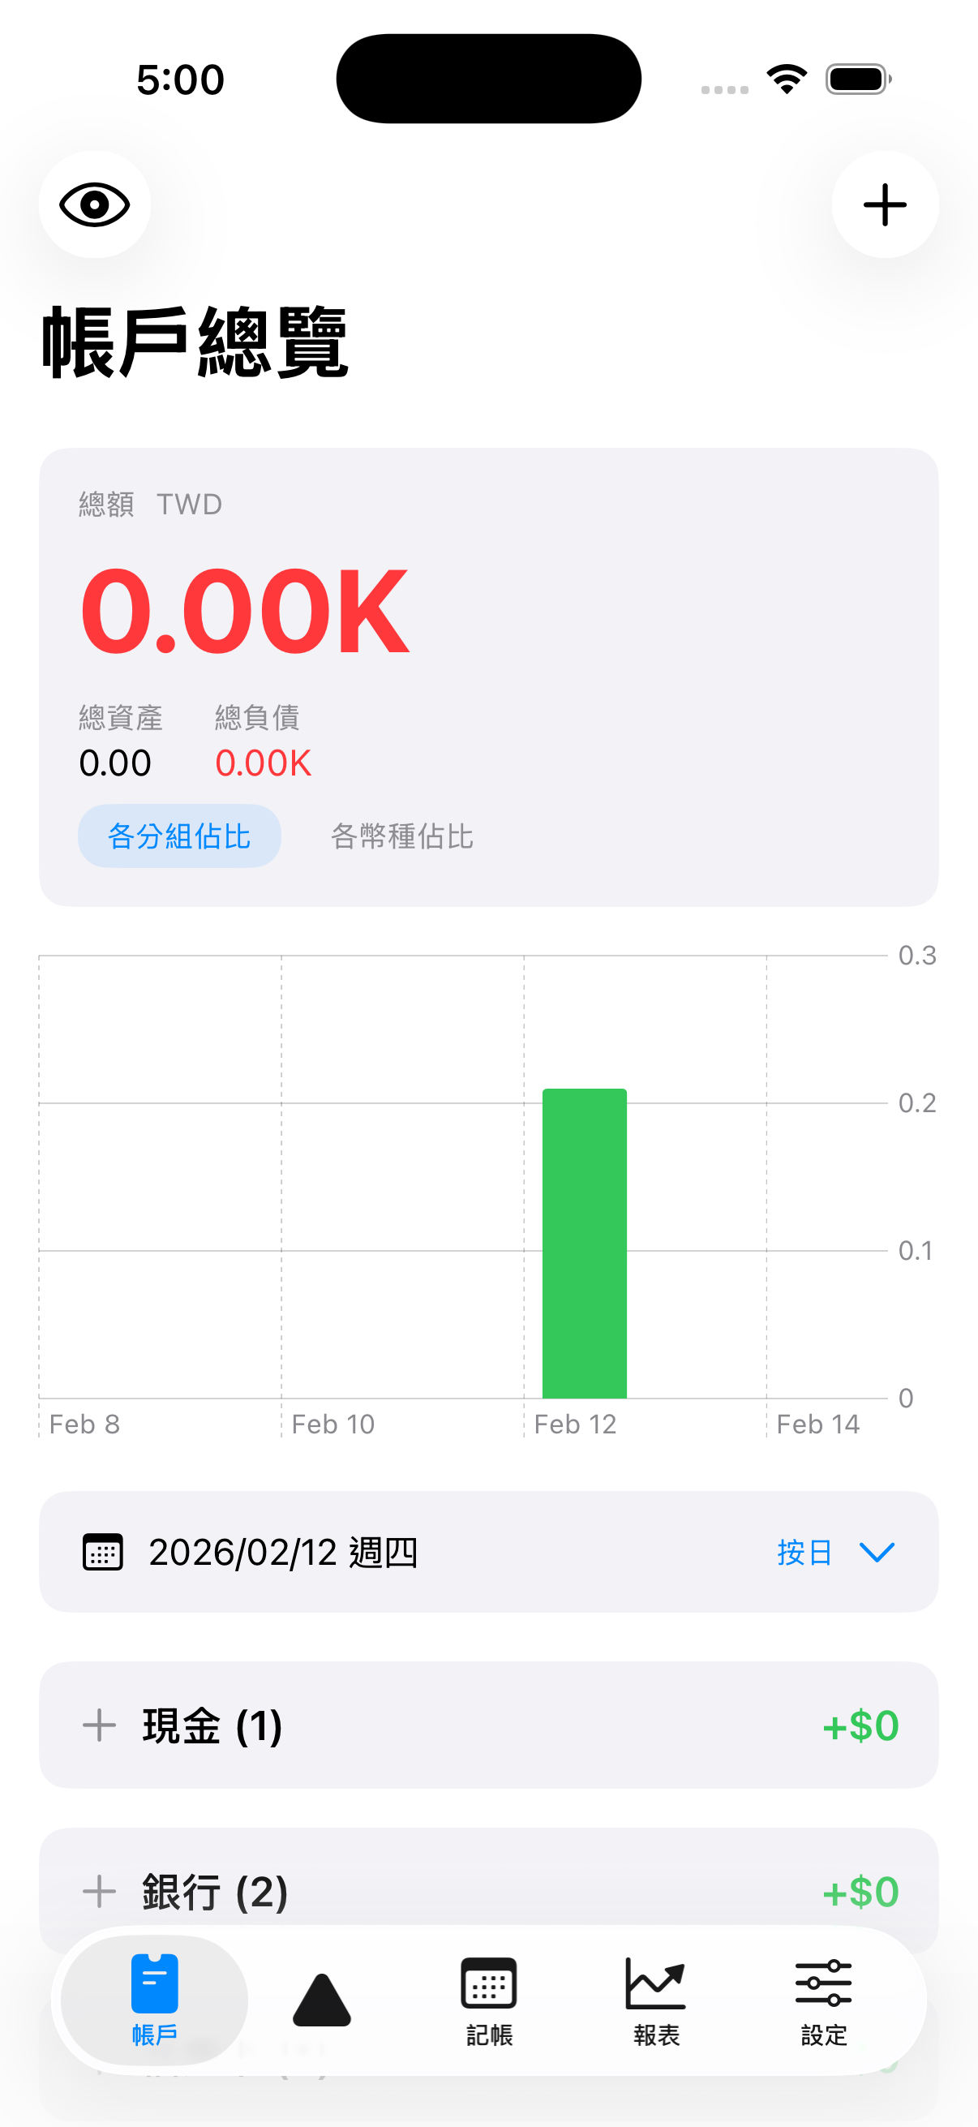
Views->Accounts->AccountsView
Click action: showingAddAccount = true
-> Call AddAccountView
Click Action: 還沒用
totalSummaryCard
(功能完善)
(balance data修正)
帳戶總覽移動到上層置中
balanceChart
(與dataSelector連動)
dataSelector(功能完善)
accountGroups (AccountGroupView.swift)

Slide 19
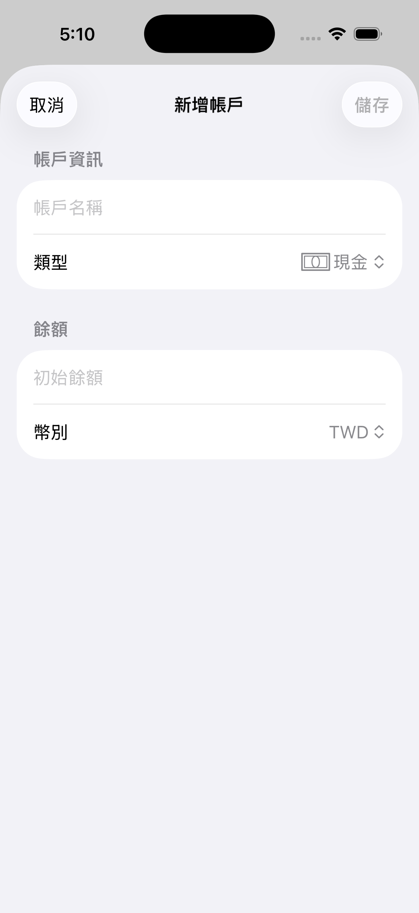
Views->Accounts->AddAccountView
幣別擴增
匯率計算

Slide 20
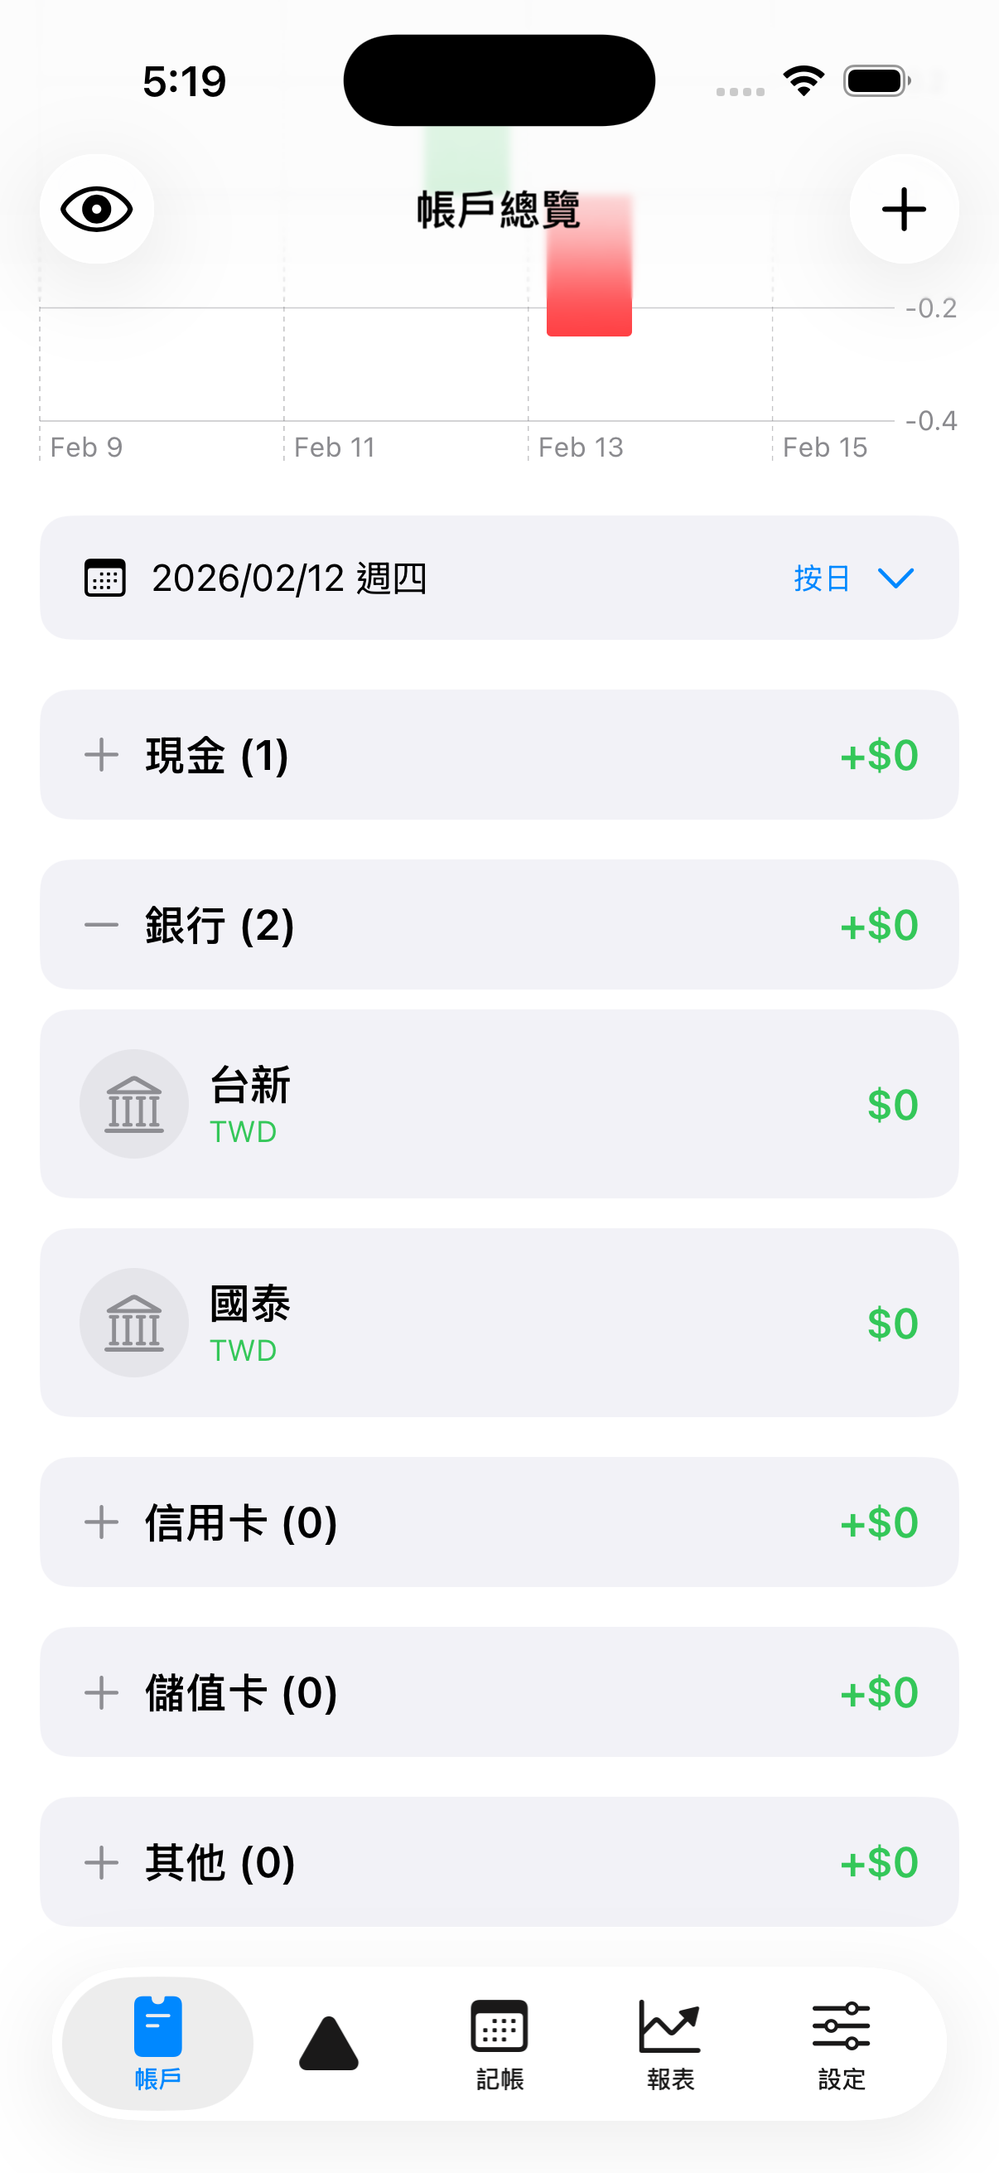
Views->Accounts->Components->AccountGroupView
1.控制單行格式，顯示項目(+ type accounts.count. (space). total)
2. 控制+-的buttom isExpanded邏輯
1.沒有跟transaction的帳戶類別聯動, total有問題
2.一次只能開啟一個項目

Slide 21
Views->Accounts->Components->AccountRowView
1.控制單行格式，顯示項目
1.幣值顯示討論
2.Icon需不需要自訂
3.點擊可觀看該週期區間(dataSelection)獨立圖表

Slide 22
Views->Calendar

Slide 23
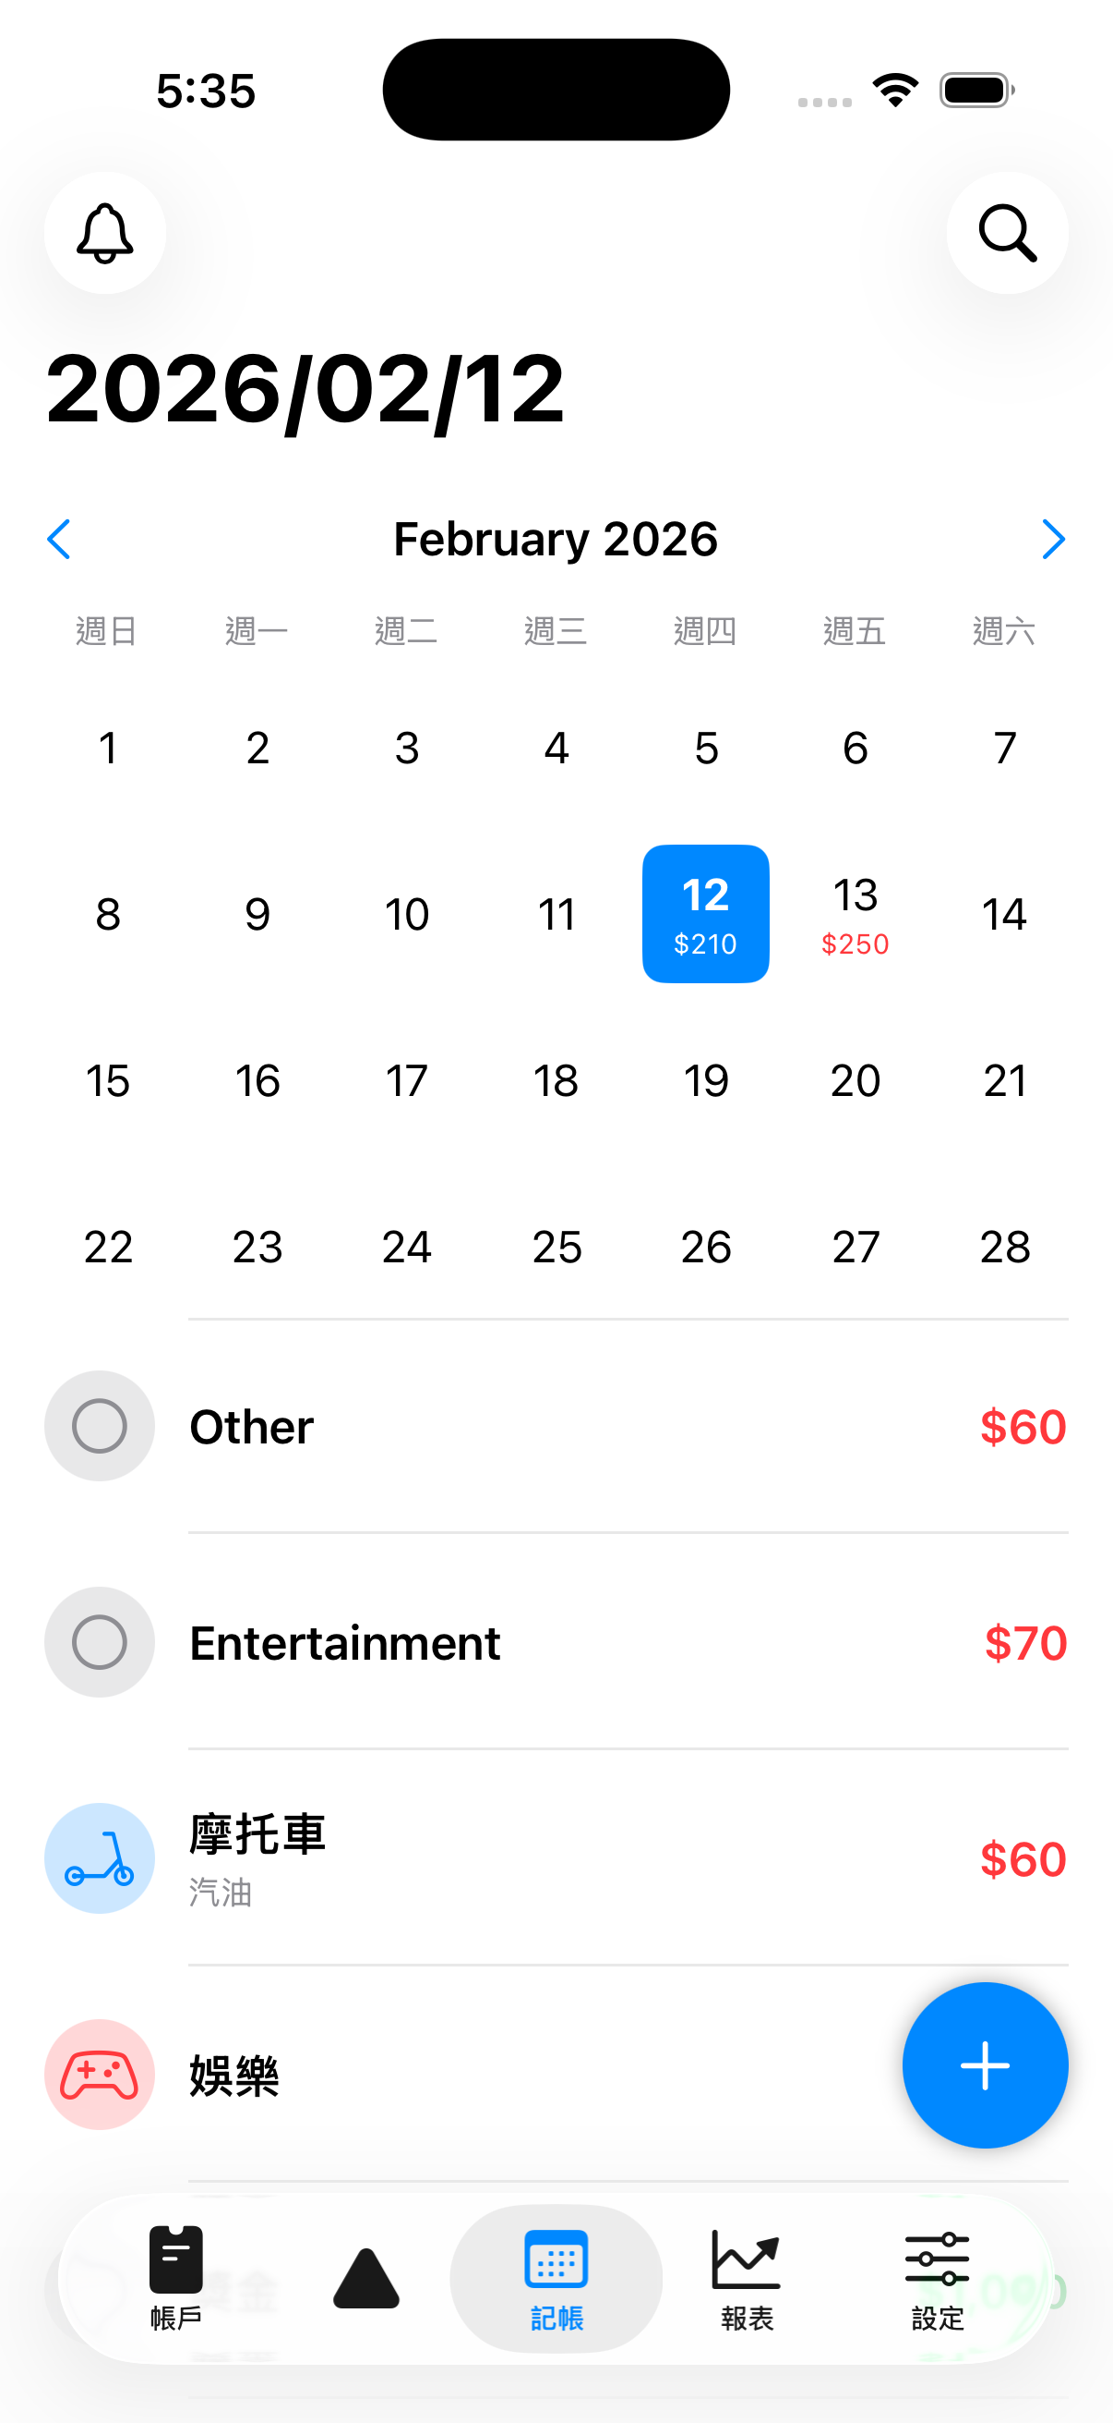
Views->Calendar->CalendarView
1.控制這頁的顯示邏輯
2個icon功能考慮刪(or 留 search, add showHide)
monthTitle
monthTitle移動到上層置中
monthHeader (可取消，用手swipe控制)
calendarGrid
(CalendarGridView)
transactionsList
(TransactionRowView)
Click Action: showingAddTransaction = true
AddTransactionView(selectedDate: selectedDate)

Slide 24
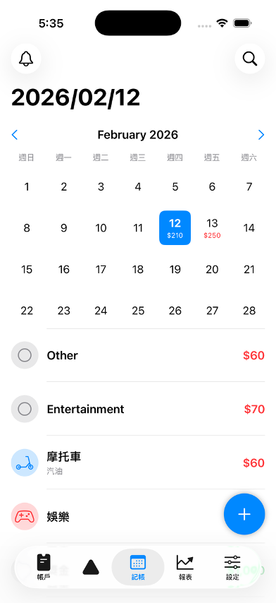
Views-> Calendar->Components->CalendarGridView

Slide 25
Views-> Calendar->Components->DayCellView

Slide 26
Views-> Calendar->Components->TransactionRowView
Note縮圖無顯示，有名稱則取代category.確認merchant顯示
點擊出現新的view, 有詳細資訊，編輯/刪除/複製功能(Calendar邏輯)

Slide 27
Views->Reports

Slide 28
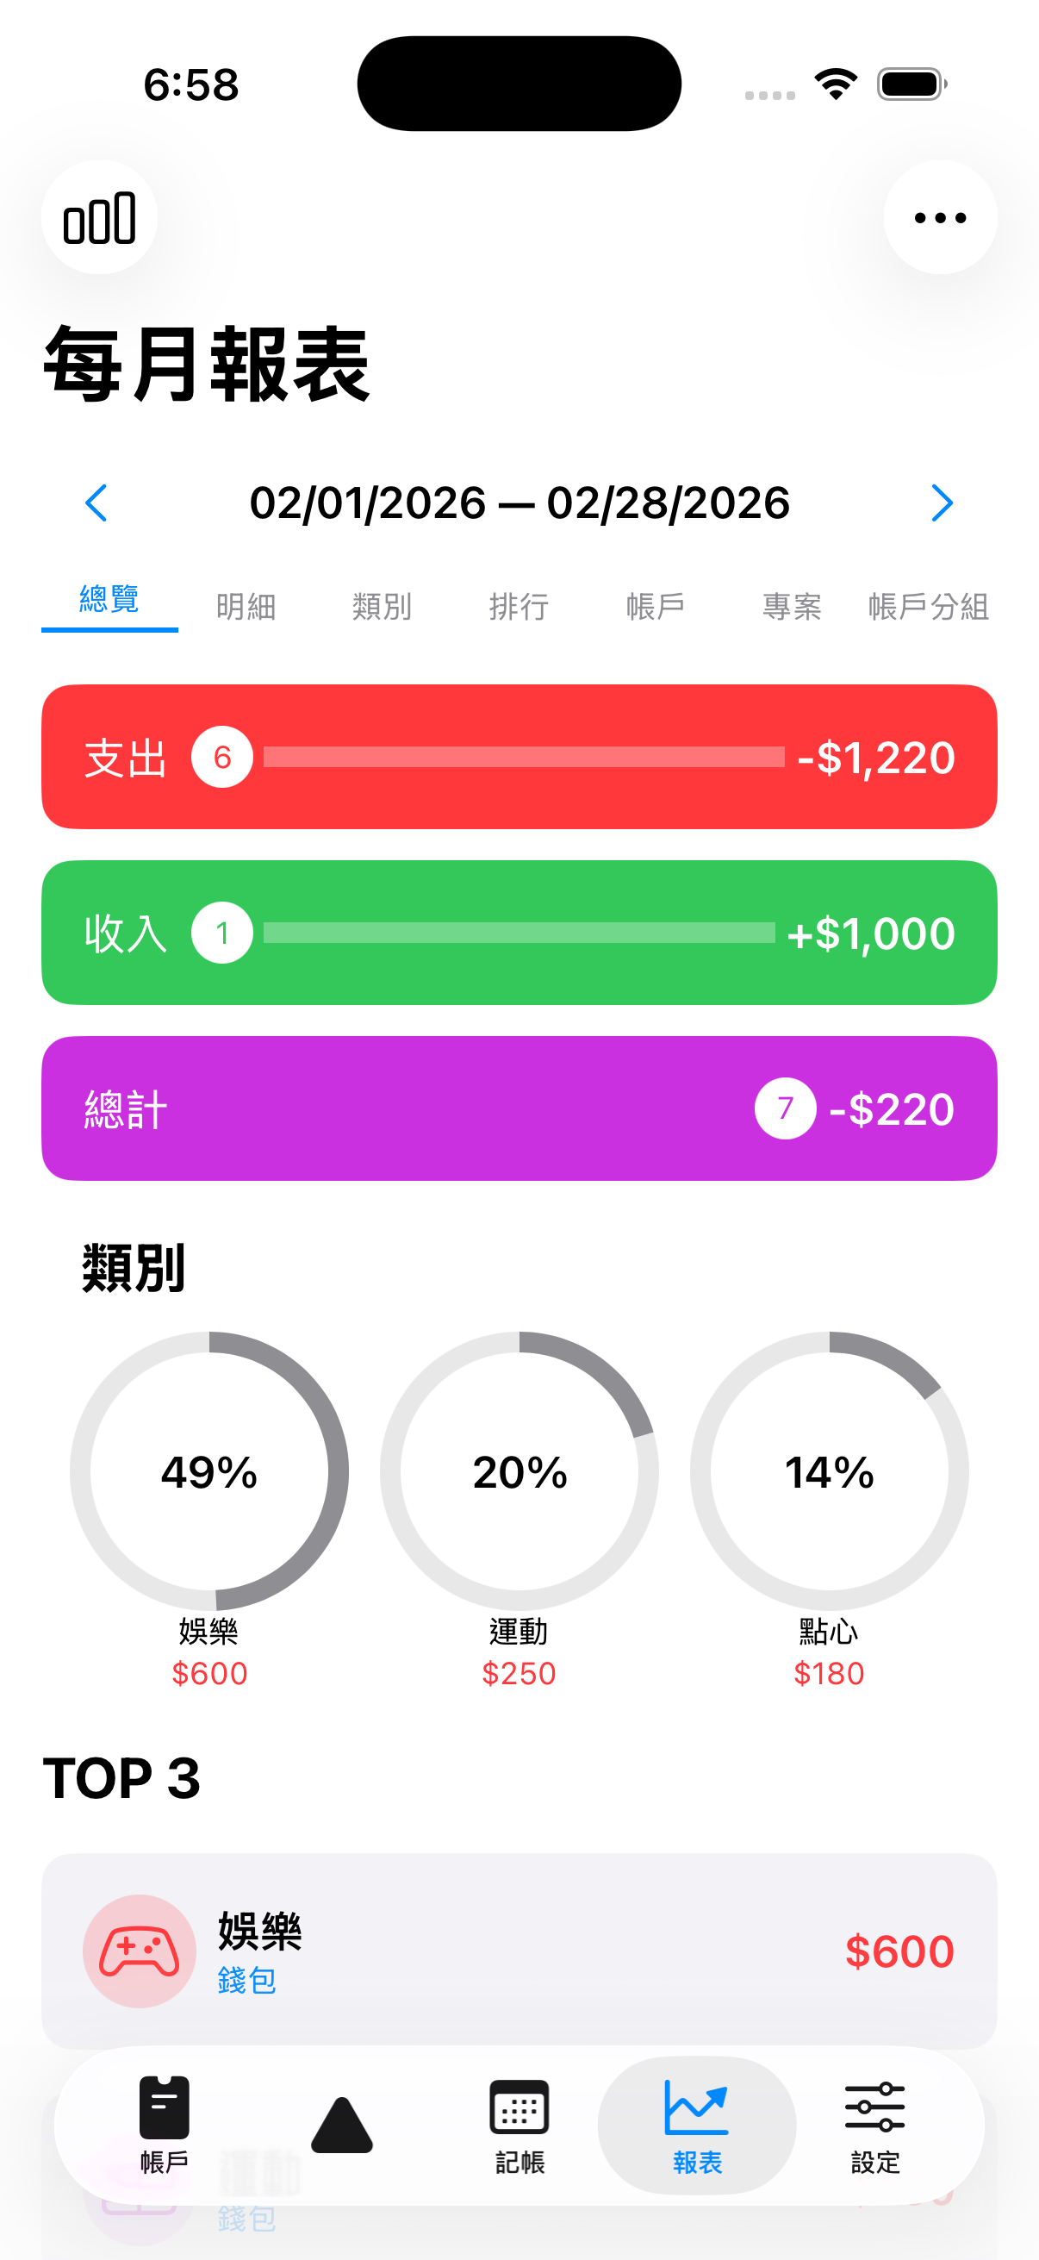
Views-> Reports->MonthlyReportView
categoryColor刪, use CategoryIcon
categorySubtitle刪, use TransactionRow format
monthSelector
tabSelector (各分組view)
summaryCards (click show all purchase view)
categoryBreakdown (color對應category color)
topThree (use TransactionRow spec)

Slide 29
Views->Settings

Slide 30
Views->Settings->SettingsView
主幣種留(不知道會有何用), 其他幣種設定匯率
資料管理所有功能完善
載具相關設定
帳號綁定(載具, ios & mac)
備份
theme

Slide 31
Views->Transactions

Slide 32
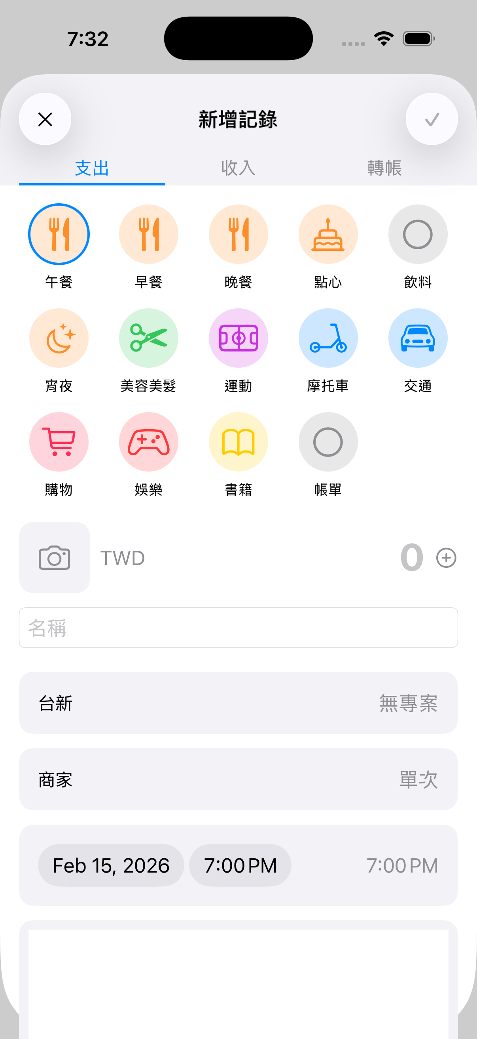
Views->Transactions->AddTransactionView
typeSelector
1. Category分組(同前面)
categoryGrid
Camera & +功能暫不需要
輸入金額區給簡易計算機
幣別根據下方選取
amountSection
detailSection
分割各功能，能選取對應的項目(account, merchant, time, date) (專案跟單次取消, 後續新增)
Notes區介紹使用

Slide 33
CICD
https://hackmd.io/@C_fXDNkoRIiU4SIzsbGSkg/H1CNs-MdZl

Slide 34
FinanceAppTests

Slide 35
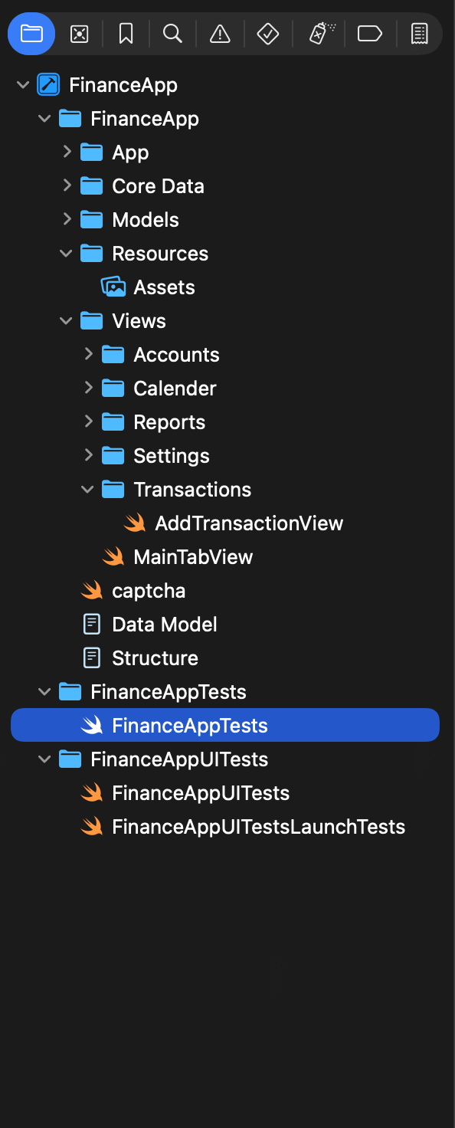
FinanceAppTests
Tests individual functions in isolation:
testTransactionTypeExpense()
└── Creates a transaction type
└── Checks rawValue == "支出"
└── Checks systemImage == "minus.circle.fill"
testCreateExpenseTransaction()
└── Creates a real transaction in memory
└── Checks amount == 100.0
└── Checks category == "午餐"
└── Checks accountName == "錢包"
testBalanceCalculation()
└── Checks 10000 - 500 == 9500
└── Pure math logic verification
testStartOfMonth()
└── Checks Date().startOfMonth().day == 1
邏輯測試： 資料有無聯動, 數字新增有無正確。可否成功使用新建的account, transaction, category default data存在
尚有非常多需要新增、修改。
每個測試邏輯都要

Slide 36
FinanceAppUITests

Slide 37
FinanceAppUITests
Tests the actual app interface:
testAppLaunchesSuccessfully()
└── Launches the app
└── Checks it didn't crash
testCalendarTabNavigation()
└── Taps "記帳" tab
└── Checks calendar appears
testAddTransactionSheetOpens()
└── Taps "+" button
└── Checks sheet opens
testAddTransactionDismiss()
└── Opens add transaction sheet
└── Taps "✕" button
└── Checks sheet closed
UI測試： App 正確launch, 每個頁籤與按鈕點擊後有正確出現效果(成功跳至另個畫面，錯誤則會傳error讓app崩潰)
尚有非常多需要新增、修改。
每個按鈕都要

